Slide 1
FINGERPRINT IDENTIFICATION WITH
FUSION OF GABOR AND MINUTIAE FEATURES USING BPNN CLASSIFIER
Under the guidance Of: Dr.P.P.S.Subhashini M.Tech., Ph.D Associate Professor
B-17 Batch:
J. Lakshmi Bhavani (Y20EC075)
Kalyan Kuna (Y2OEC079)
L. Jagadeeswara rao (Y20EC109)

Slide 2
Contents
Abstract
Introduction
Applications
Block Diagram
Morphological Operations
Dimensionality Reduction
Results
Bar Graph
Conclusion
References

Slide 3
Abstract
Fingerprint identification is a task of personal identification and verification.
Fingerprint Identification system consists of two modules that are training and testing.
In this project, The feature vector is formed using combined features
obtained from Gabor filtering technique and minutiae technique.
To address dimensionality concerns, Principal Component Analysis (PCA) is applied.
The dataset, comprising the fused features and corresponding labels, is then loaded for the final step - classification using a BPNN.

Slide 4
Introduction
This study focuses on advancing fingerprint identification through the application of Back Propagation Neural Network (BPNN), a prominent deep learning technique.
Fingerprint identification plays a pivotal role in various domains such as law enforcement, access control, and immigration.
Traditional methods of fingerprint analysis have relied on manual interpretation and feature extraction, which can be time-consuming and prone to error.
By employing BPNN, which are capable of learning intricate patterns and
features directly from raw data, this research seeks to enhance the accuracy and efficiency of fingerprint identification.

Slide 5
Introduction
The classification task involves categorizing fingerprints into distinct patterns, including Arch, Left Loop, Right Loop, Tented, and Whorl. BPNN offer significant advantages in handling complex data structures like fingerprint images, making them well-suited for this classification task.
The utilization of BPNN in fingerprint identification holds promise for improving biometric security systems, streamlining identification processes, and enhancing overall security measures.

Slide 6
Applications
Biometric Security.
Fingerprint help police catch criminals and track suspects in investigations.
Fingerprint systems help border control verify travelers and spot fake documents.
Fingerprint security safeguards banking, blocks unauthorized access to accounts and data.

Slide 7
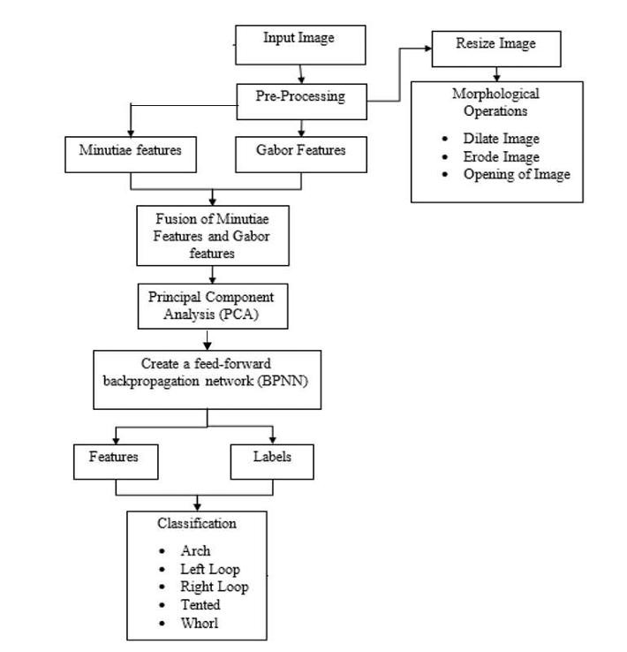
Block Diagram

Slide 8
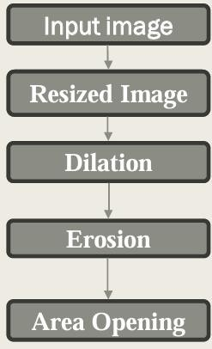
Morphological Operations Flow Chart

Slide 9
Morphological Operations
Before adopting a fingerprint image into the proposed automatic system, it was preprocessed using a window of size 227×227 pixels.
Then the morphological operations were performed to augment the ridges of the fingerprint images.
The ridge width should be decreased so that the ridge end and bifurcates in the fingerprint could be detected easily.
This procedure was performed using erosion-dilation and area opening techniques of morphological operation

Slide 10
Resized Image
Resizing an image involves changing its dimensions, either increasing or decreasing its size.
This process is commonly performed in image processing for various reasons, such as preparing data for a specific algorithm, adjusting display
sizes, or reducing computational complexity.

Slide 11
Dilasion
It was mainly used to grow an object in size by extracting the outer boundaries of the given fingerprint image.
Dilation continuously filled the missing pixel of a broken ridge as it added pixels at the boundary of the objects.
Having applied this operation, the object enlarged its regions, shrank the single hole and reduced the gap between two regions.

Slide 12
Erosion
This was used as the complement operation of dilation to smooth the fingerprint image after dilation.
It caused to loss of size by extracting inner boundaries of a fingerprint edge.
Therefore, it can be used to remove the noisy connections between the two objects.
Area Opening
In the opening operation, the image was first eroded and then dilation was carried out to smoothen the contour of fingerprint image by clearing the narrow bridge and eliminating the minor extension present in the object.

Slide 13
Extraction of Gabor Features
The Gabor filter to analyze an image. Gabor filters are commonly used in image processing for texture analysis and feature extraction.
Gabor filter was used in the system to improve the ridges and relax the valleys by implementing short term Fourier transformation with Gaussian window in a spatial domain
It assisted in obtaining the deviations in the textures and characteristics in the fingerprint image for different orientations and scales.

Slide 14
Extraction of Minutiae Features
The most important step in automatic fingerprint matching is to reliably extract the minutiae from the captured fingerprint images.
Minutiae points are the major features of a fingerprint image and are used in the matching of fingerprints.
These minutiae points are used to determine the uniqueness of a fingerprint image.
A good quality fingerprint image can have 25 to 80 minutiae depending on the fingerprint scanner resolution and the placement of finger on
the sensor.

Slide 15
Principal Component Analysis
The principal component analysis (PCA) is a kind of algorithms in biometrics.
Principle component analysis is the most popular methods used mainly for dimensionality reduction in recognition problem to extract the region of interest features.
This is done by the removal of redundant and unwanted data economically.
PCA is employed to map data from a high dimensional space to a low dimensional space by a mathematical procedure using its linear transformation

Slide 16
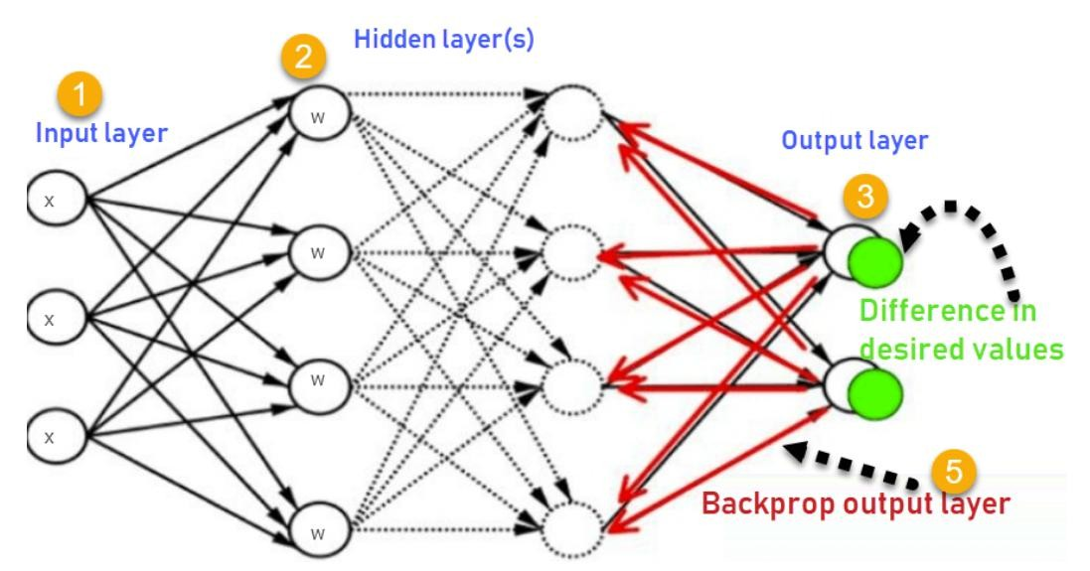
Mechanism of BPNN

Slide 17
How Backpropagation Algorithm Works?
Inputs X, arrive through the preconnected path
Input is modeled using real weights W. The weights are usually randomly selected.
Calculate the output for every neuron from the input layer, to the hidden layers, to the output layer.
Calculate the error in the outputs.
Error = Actual Output – Desired Output
Travel back from the output layer to the hidden layer to adjust the weights such that the error is decreased.
Keep repeating the process until the desired output is achieved

Slide 18
How Backpropagation Algorithm Works?
Most prominent advantages of Backpropagation are:
Backpropagation is fast, simple and easy to program
It has no parameters to tune apart from the numbers of input
It is a flexible method as it does not require prior knowledge about the network.
It is a standard method that generally works well.
It does not need any special mention of the features of the function to learned.

Slide 19
Dataset:
NIST(National Institute of Standards and Technology) is a well-known dataset of Finger- print Images, often used as a benchmark for image classification tasks.
The dataset consists of a total of 125 images, of which 25 are for whorl, 25 are for right loop, 25 are for left loop, 25 are for arch, and 25 are for tented, which are black and white images.
Out of these, 70% is used for training the classifier, and 30% is used for testing. Each image in the NIST dataset with dimensions of different pixels.

Slide 20
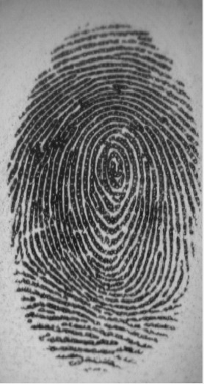
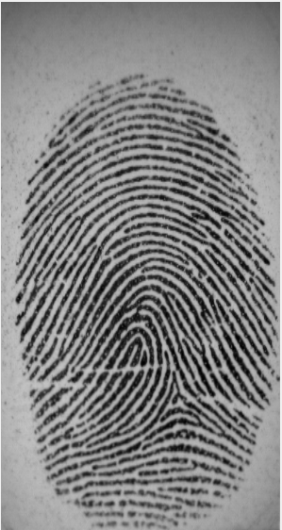
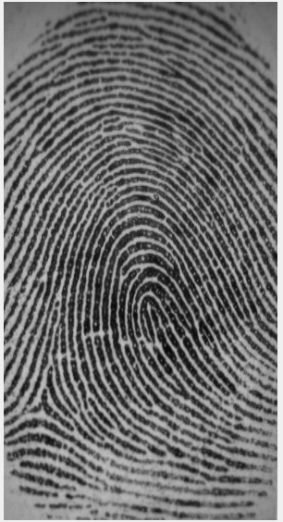
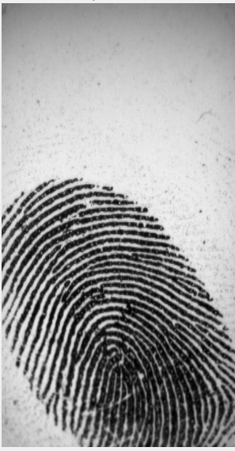
Input Images
Whorl input image
Arch input image
Left Loop input image
Right Loop input image
Tented input image

Slide 21
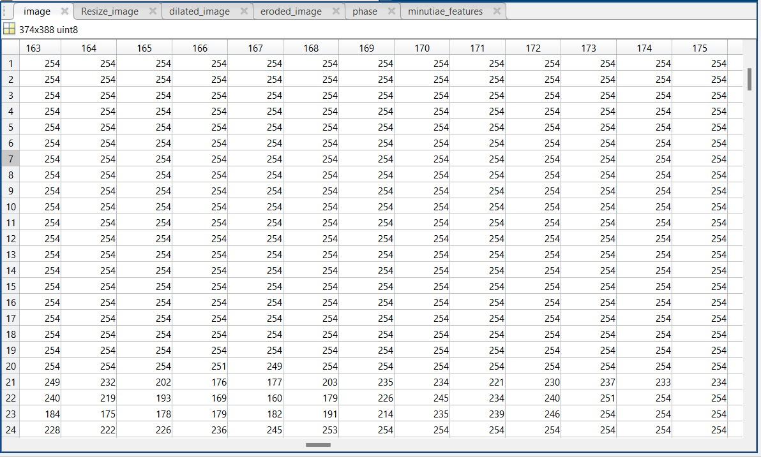
374x388 Pixel Image of Whorl Input Image

Slide 22
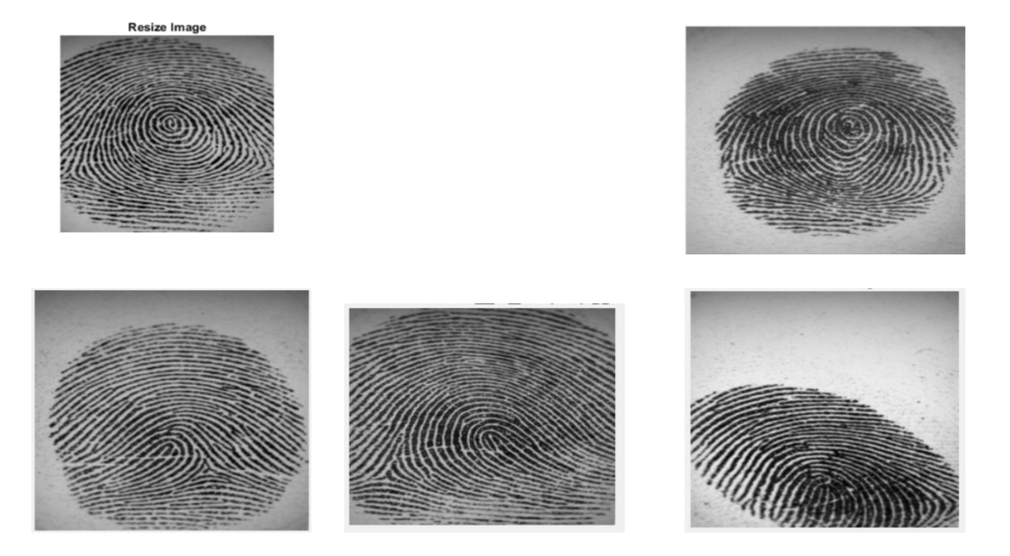
Resized Images

Slide 23
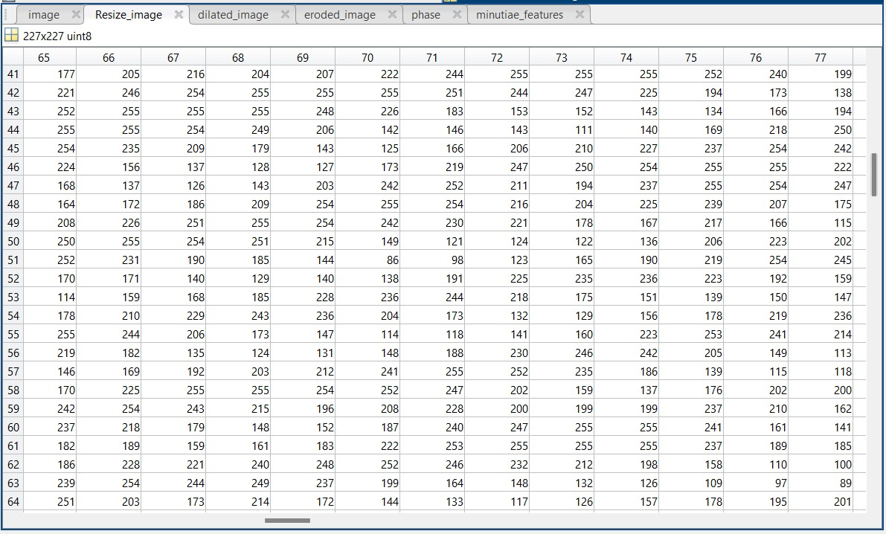
277x277 Pixel Image of whorl Resized Image

Slide 24
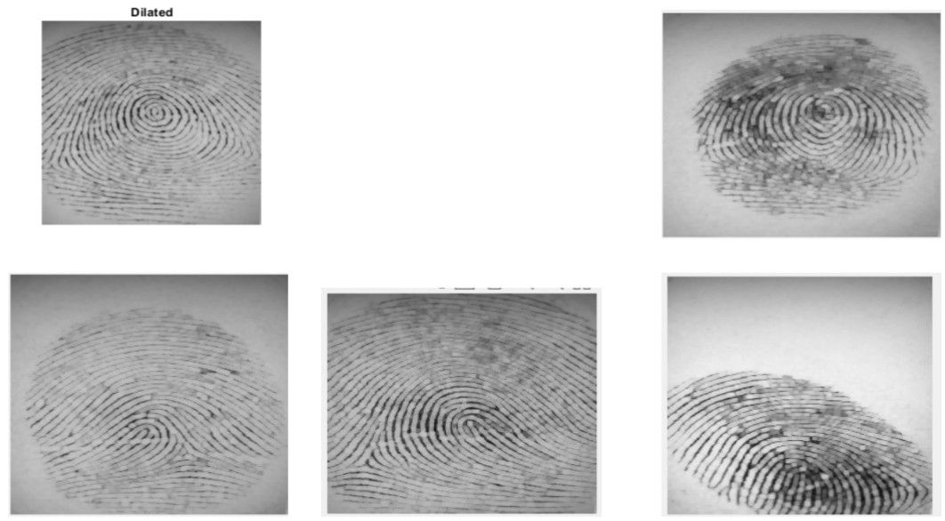
Dilated Images

Slide 25
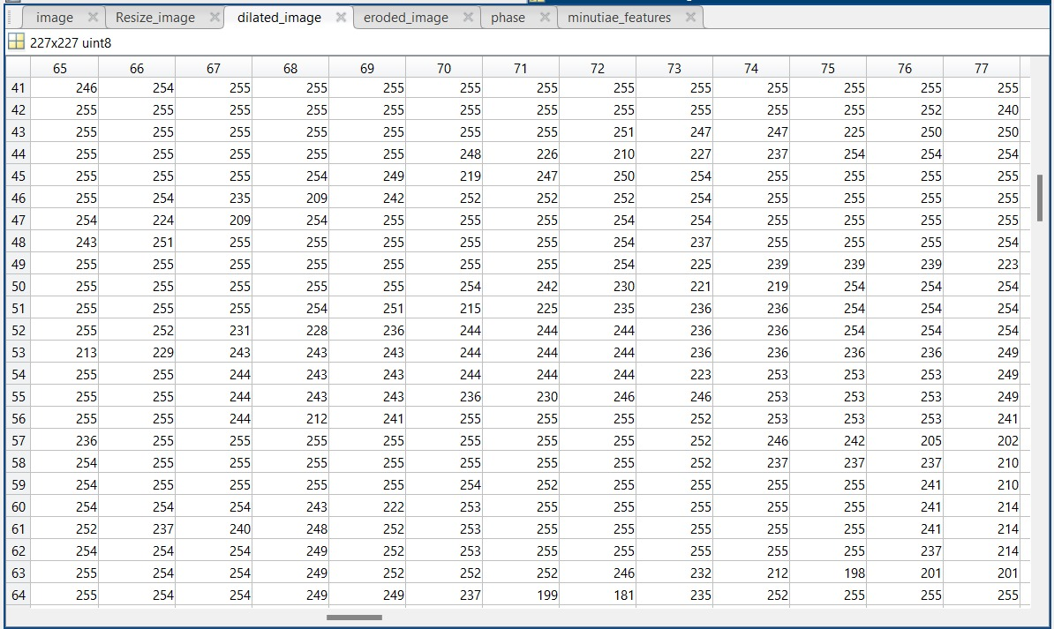
277x277 Pixel Image of Whorl Dilated Image

Slide 26
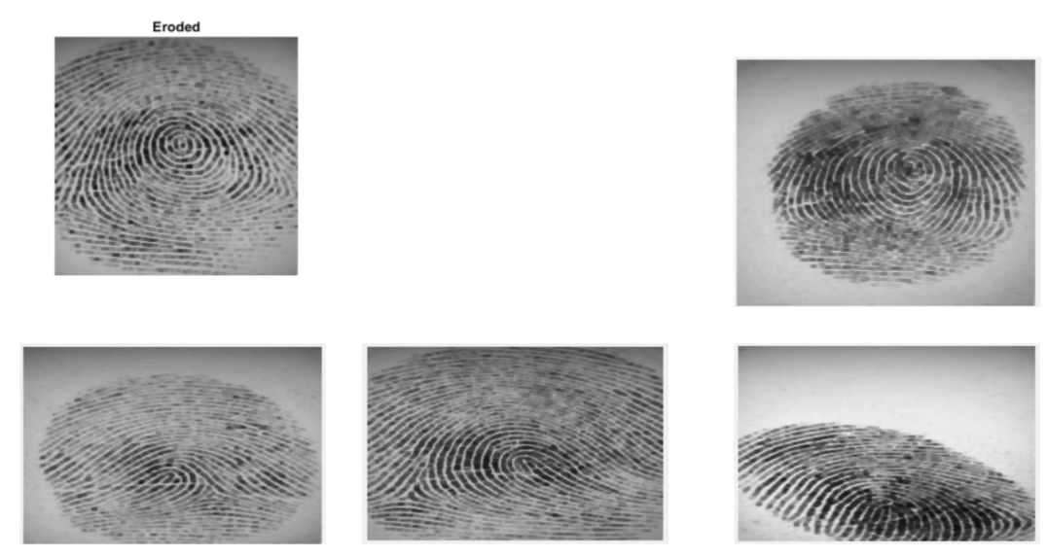
Eroded Images

Slide 27
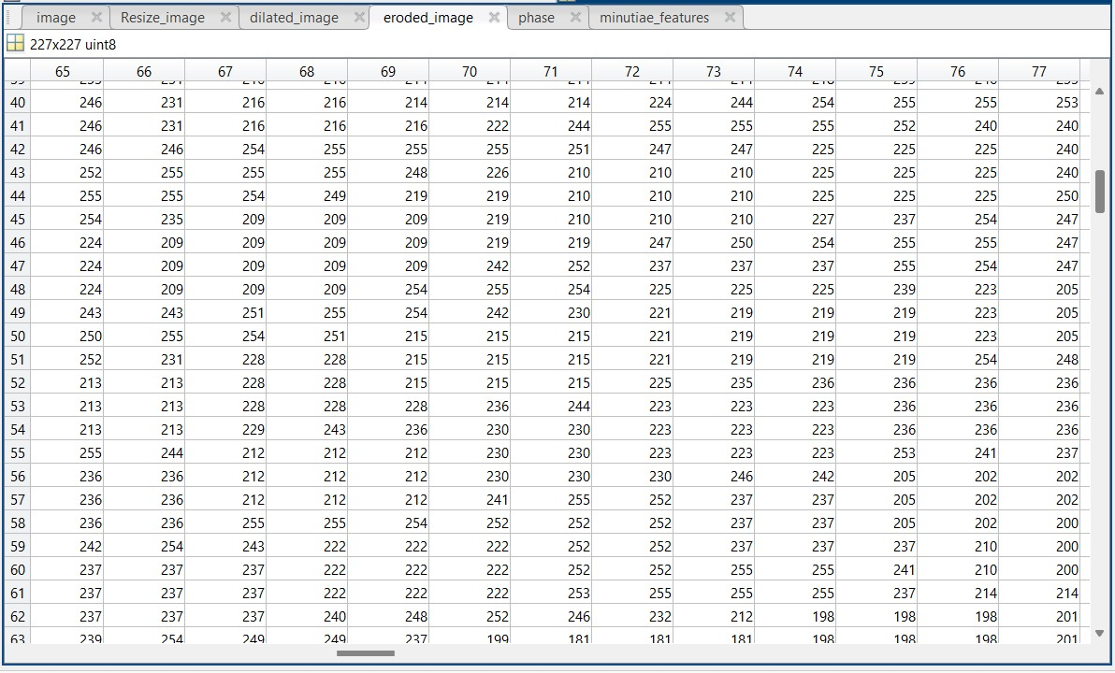
277x277 Pixel Image of Whorl Eroded Image

Slide 28
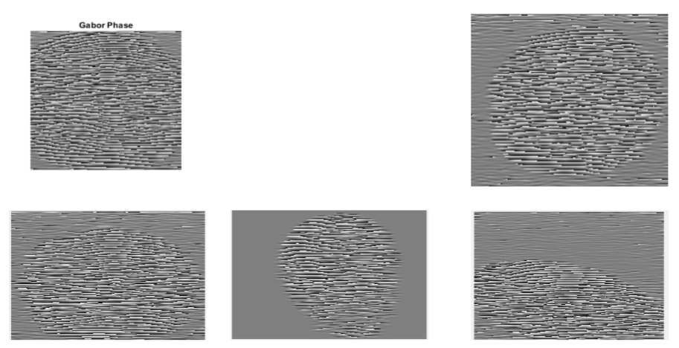
Gabor Phase Images

Slide 29
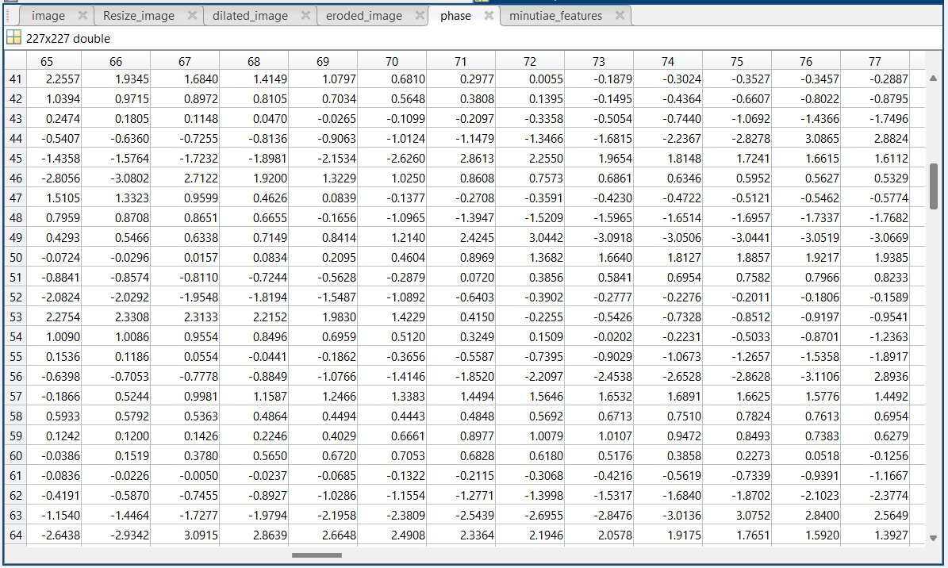
277x277 Pixel Image of Whorl Gabor Feature Image

Slide 30
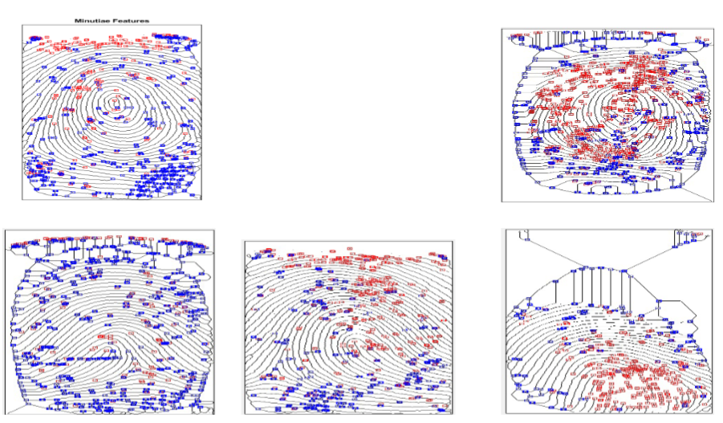
Minutiae Features Images

Slide 31
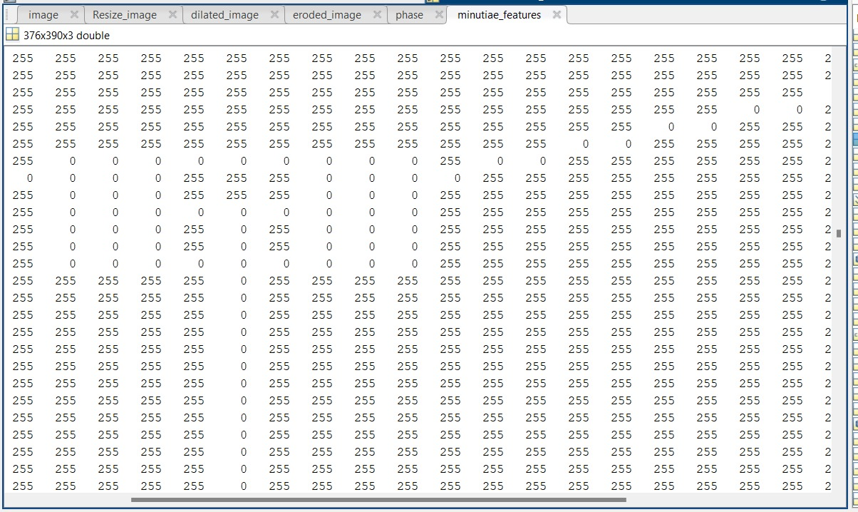
376x390x3 Pixel Image of Whorl Minutiae Feature Image

Slide 32
Kurtosis Values
In Principal Component Analysis (PCA), kurtosis helps us understand how the variables in our dataset are spread out. When kurtosis is high, it means the tails of the distribution are heavier, suggesting the data might not follow a normal pattern. This can affect how well PCA works.
By spotting variables with high kurtosis, we can tell if we need to change the data or try different techniques to make PCA work better. Looking at kurtosis alongside other measures can help us pick the most important components more accurately, giving us a clearer picture of the data’s variation.
Each column in our dataset represents the kurtosis values for different types of images, like Arch, Tented, Left Loop,Right Loop and Whorl, with each type having 25 images.

Slide 33
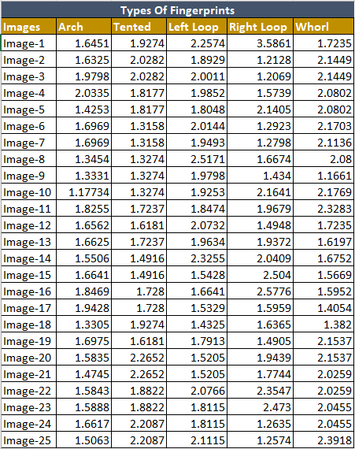
25X5 Kurtosis Values Of different types of Fingerprint Images

Slide 34
Confusion Matrix:
A confusion matrix is a table that is used to evaluate the performance of a classification model by comparing the predicted and actual class labels of a set of test data. The matrix shows the number of true positives, true negatives, false positives, and false negatives, arranged in a tabular form.
In a binary classification problem, a confusion matrix typically has two rows and two columns. The rows represent the predicted class labels (positive or negative), while the columns represent the actual class labels.

Slide 35
Confusion Matrix(contd..):
The four entries of the matrix are defined as follows:
True positives (TP): the number of positive examples that were correctly classified as positive.
True negatives (TN): the number of negative examples that were correctly classified as negative.
False positives (FP): the number of negative examples that were incorrectly classified as positive.
False negatives (FN): the number of positive examples that were incorrectly classified as negative

Slide 36
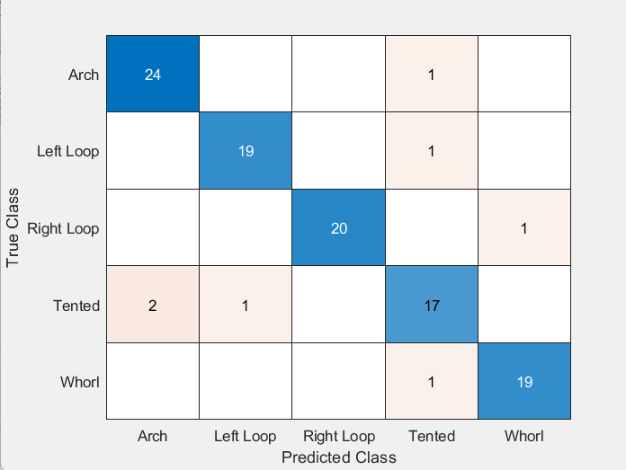
Confusion matrix for CNN

Slide 37
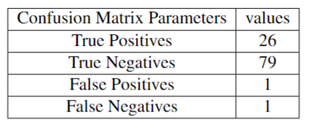
Confusion Matrix Parameters for CNN
Accuracy = (TP+TN)/(TP+TN+FP+FN)= 98%

Slide 38
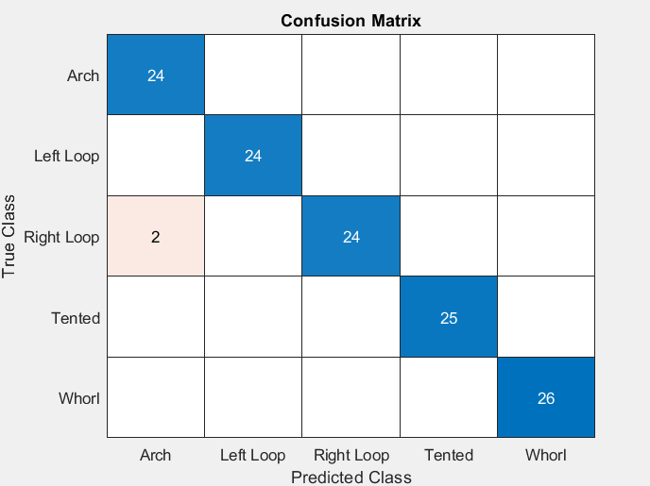
Confusion matrix for BPNN

Slide 39
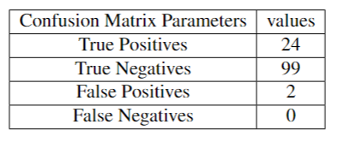
Confusion Matrix Parameters for BPNN
Accuracy = (TP+TN)/(TP+TN+FP+FN)= 98.6%

Slide 40
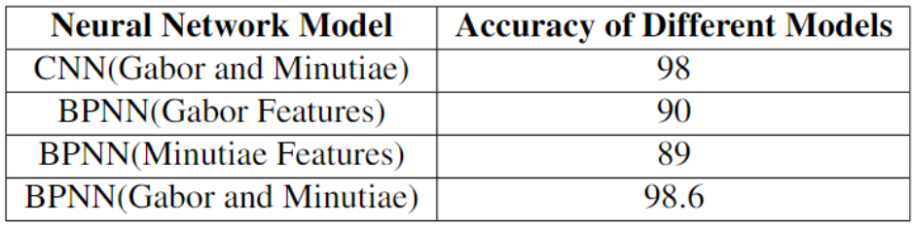
Comparison for different models:

Slide 41
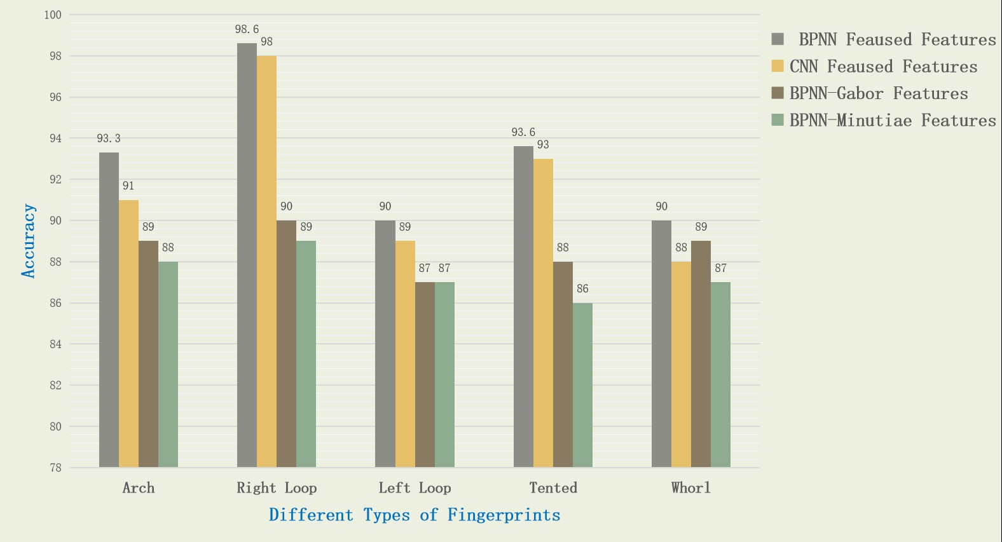
Comparison of Accuracy:

Slide 42
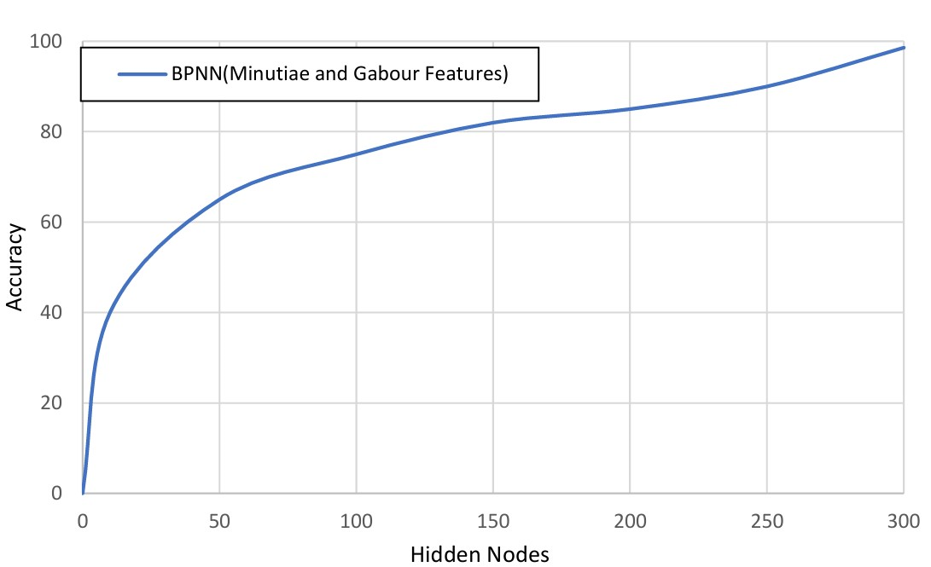
Comparison of accuracy relative to variations in the number of hidden nodes

Slide 43
Conclusion
The fusion of Gabor and Minutiae features coupled with a BPNN classifier presents a robust approach to fingerprint identification.
Through the systematic process involving preprocessing, feature extraction, fusion, dimensionality reduction, and classification, the system achieves accurate identification of various fingerprint patterns including arches, loops, tented arches, and whorls.
The application of morphological operations, PCA for dimensionality reduction, and the utilization of a BPNN classifier contribute to the system's reliability and efficiency.

Slide 44
References
[1] Hasan H, Abdul-Kareem S. Fingerprint image enhancement and recognition algorithms: a survey. Neural Comput Appl 2013;(23):1605–10.
[2] Win KN, Li K, Chen J, Viger PF, Li K. Fingerprint classification and identification algorithms for criminal investigation: a survey. Fut Gener Comput Syst 2020; 110:758–71.
[3] Nazarkevych M, Riznyk O, Samotyy V, Dzelendzyak U. Detection of regularities in the parameters of the Ateb-Gabor method for biometric image filtration. East Eur J Enterp Technol 2019;1(2–97):57–65.

Slide 45
References
[4] Shemmary ENAAl. Classification of fingerprint images using neural networks technique. J Eng (JOE) 2012;1(3):40–8.
[5] Leung KC, Leung CH. Improvement of fingerprint retrieval by a statistical classifier. IEEE Trans Inform Forens Secur 2011;6(1):59–69.
[6] Wan GC, Li MM, Xu H, Kang WH, Rui JW, Tong MS. XFinger-net: pixel-wise segmentation method for partially defective fingerprint based on attention gates and U-net. Sensors 2020;20:4473.
[7]AlShehri H, Hussain M, AboAlSamh H, AlZuair M. A large-scale study of fingerprint matching systems for sensor interoperability problem. Sensors 2018;18: 1008.

Slide 46
THANK YOU

